Slide 1
UNIT-IV SYLLABUS Functions: Introduction – using functions – Function declaration/ prototype – Function definition – function call – return statement – Passing parameters – Scope of variables – Storage Classes – Recursive functions. Structure, Union, and Enumerated Data Types: Introduction – Nested Structures – Arrays of Structures – Structures and Functions– Union – Arrays of Unions Variables – Unions inside Structures – Enumerated Data Types.

Slide 2
STRUCTURES
A structure is a user defined data type. A structure is heterogeneous collection of related fields. Here fields are called structure elements or structure members. A structure can be considered as a template used for defining a collection of variables under a single name. Structures help programmers to group elements of different data types into a single unit.

Slide 3
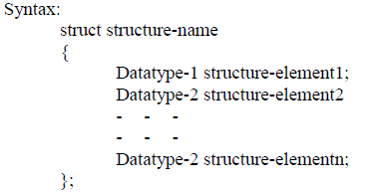

Slide 4
Here
The keyword “struct” is used to define structure.
Variables inside the structure are called structure elements.
By using structure variable we can access structure elements.
When we declare structure variable, memory allocation takes place.
Memory allocated to the structure variable is sum of individual elements in the structure.

Slide 5
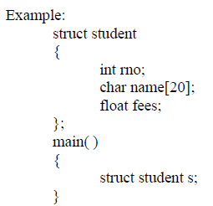
Syntax for Structure Variable:
struct structure-name variable-name;
Here rno, name, fees are called as structure elements and “s” is called as structure variable.

Slide 6
INITIALISING STRUCTURE:
The structure elements are accessed using dot ( . ) operator. It is also called as membership operator. The individual elements are initialized as follows. s.rno=10;
s.name=”Aditya”;
s.fees=1000;
We can also initialize structure element values inside curly braces, with each value separated by (,).
struct student s={10,”Aditya”,10000};

Slide 7
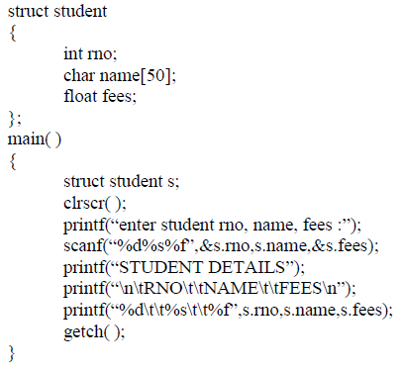
Example program how to read and write structure elements:

Slide 8
ARRAYS OF STRUCTURES:
C does not limit a programmer to storing simple data types in an array. User can define structures as an element of an array. The general syntax used for declaration of array of structures can be
Syntax:
struct structure-name variable-name[size];
Example:
struct student s[10];
This defines an array called s that has 10 elements. Each element inside the array will be of type struct student. Referencing an element in the array is as follows.
S[0] . rno=10;
S[0] . name=”Aditya”;
S[0] . fees=10000;

Slide 9
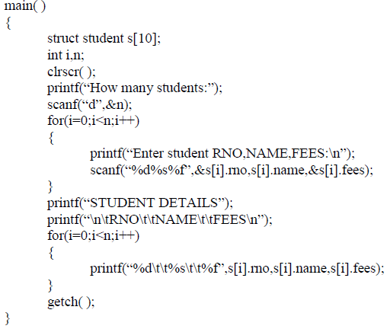
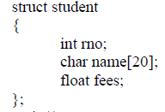
Example

